Slide 1


Azərbaycan Dövlət Neft və Sənaye Universiteti
Calculus
Multivariable

Slide 2
Complex Vector Spaces
and
Inner Products

Slide 3
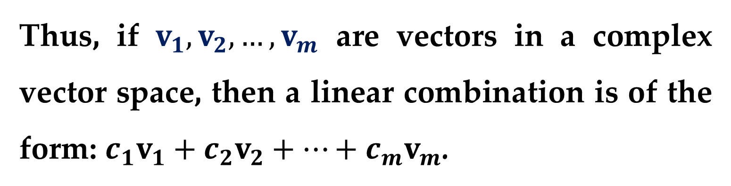
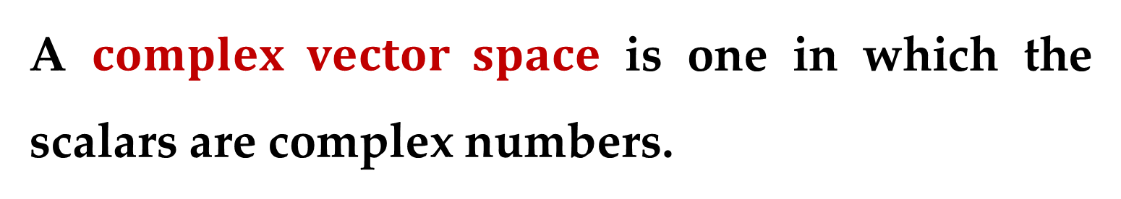
All the vector spaces we have studied thus far are real vector spaces since the scalars are real numbers.
A $complex vector space$ is one in which the scalars are complex numbers.
Thus, if $v_{1},v_{2},…,v_{m}$ are vectors in a complex vector space, then a linear combination is of the form: $c_{1}v_{1}+c_{2}v_{2}+…+c_{m}v_{m}$.

Slide 4
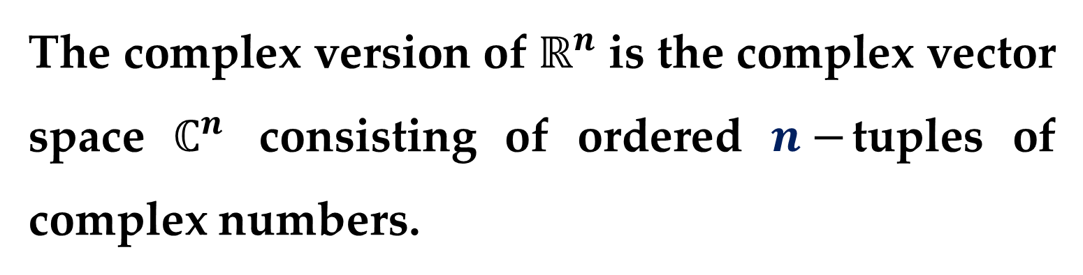
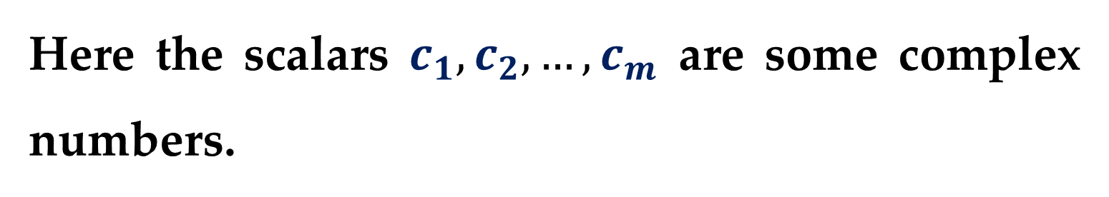
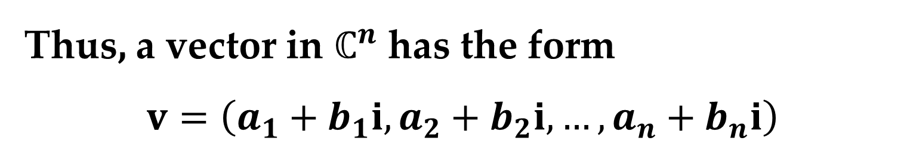
Here the scalars $c_{1},c_{2},…,c_{m}$ are some complex numbers.
The complex version of $ℝ^{n}$ is the complex vector space $ℂ^{n}$ consisting of ordered $n−$tuples of complex numbers.
Thus, a vector in $ℂ^{n}$ has the form
$$v=\left(a_{1}+b_{1}i,a_{2}+b_{2}i,…,a_{n}+b_{n}i\right)$$

Slide 5
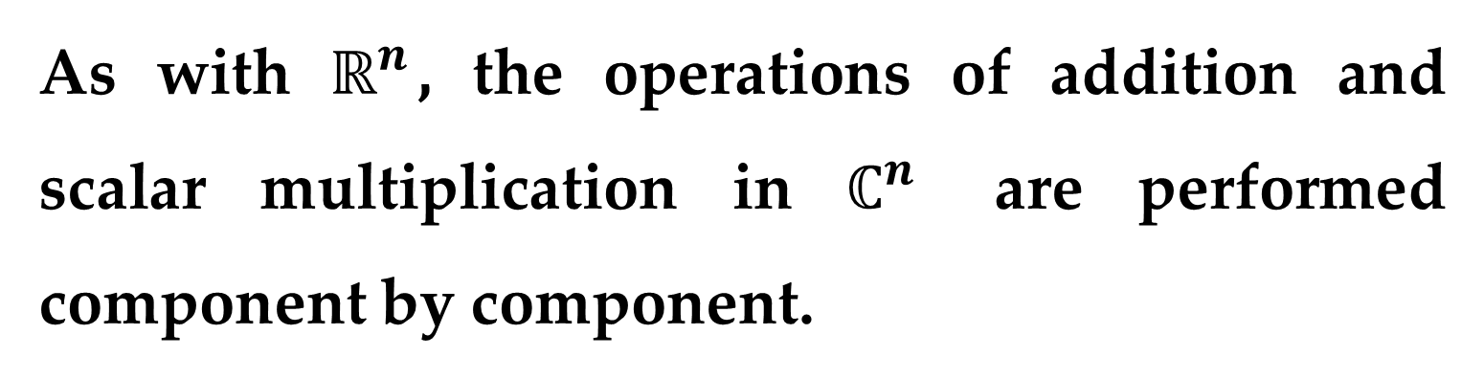
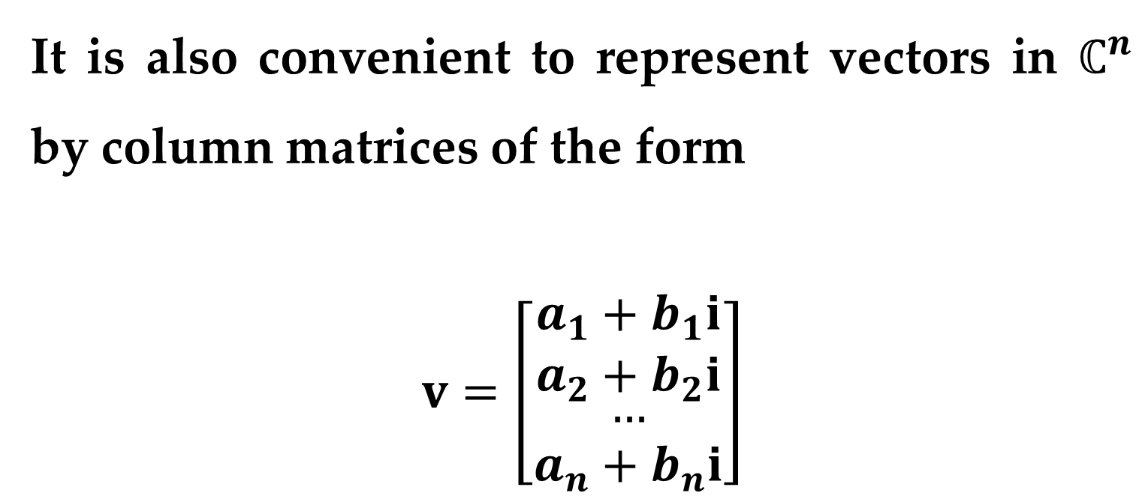
It is also convenient to represent vectors in $ℂ^{n}$ by column matrices of the form
$$v=\left[\begin{aligned}a_{1}+b_{1}i \\ a_{2}+b_{2}i \\ \begin{aligned}… \\ a_{n}+b_{n}i\end{aligned}\end{aligned}\right]$$
As with $ℝ^{n}$, the operations of addition and scalar multiplication in $ℂ^{n}$ are performed component by component.

Slide 6
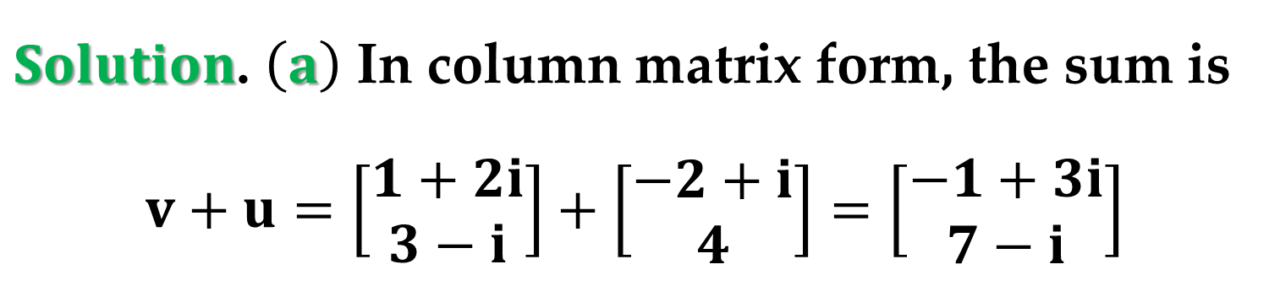
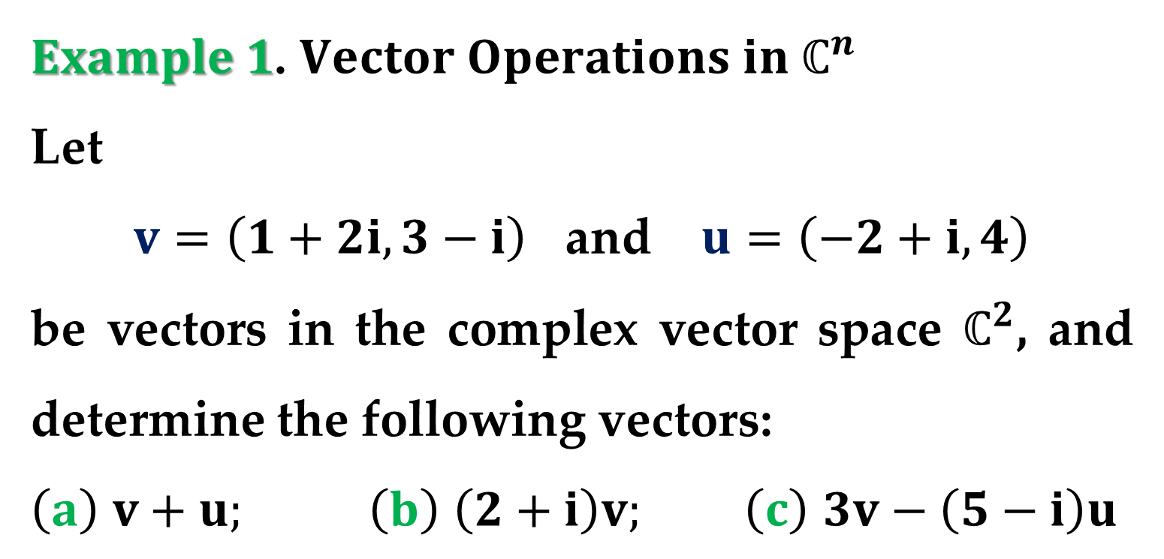
$Example 1$. $Vector Operations in ℂ^{n}$
Let
$v=\left(1+2i,3−i\right)$ and $u=\left(−2+i,4\right)$
be vectors in the complex vector space $ℂ^{2}$, and determine the following vectors:
$\left(a\right)$ $v+u;$ $\left(b\right)$ $\left(2+i\right)v;$ $\left(c\right)$ $3v−\left(5−i\right)u$
$Solution$. $\left(a\right)$ In column matrix form, the sum is
$$v+u=\left[\begin{aligned}1+2i \\ 3−i\end{aligned}\right]+\left[\begin{aligned}−2+i \\ 4\end{aligned}\right]=\left[\begin{aligned}−1+3i \\ 7−i\end{aligned}\right]$$

Slide 7
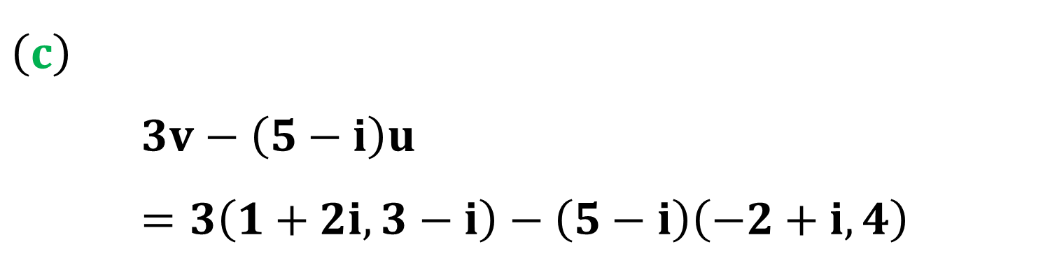
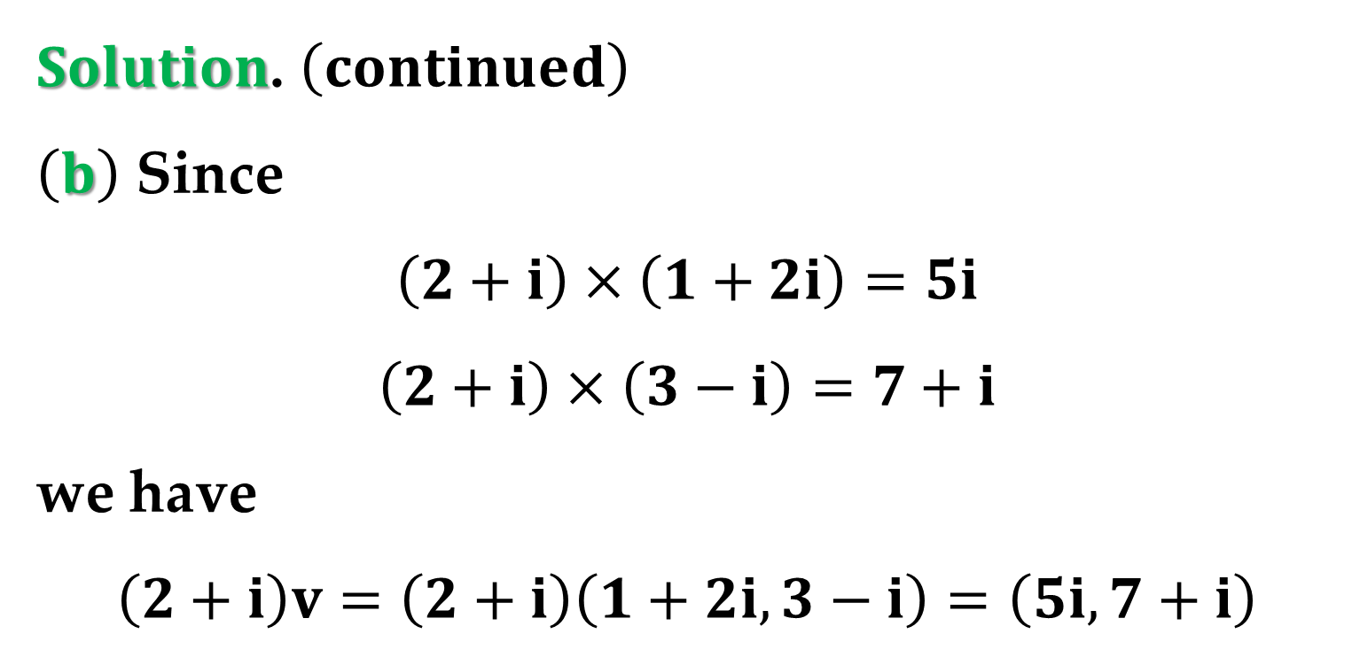
$Solution$. $\left(continued\right)$
$\left(b\right)$ Since
$$\left(2+i\right)×\left(1+2i\right)=5i$$
$$\left(2+i\right)×\left(3−i\right)=7+i$$
we have
$$\left(2+i\right)v=\left(2+i\right)\left(1+2i,3−i\right)=\left(5i,7+i\right)$$
$\left(c\right)$
$$3v−\left(5−i\right)u=3\left(1+2i,3−i\right)−\left(5−i\right)\left(−2+i,4\right)$$

Slide 8
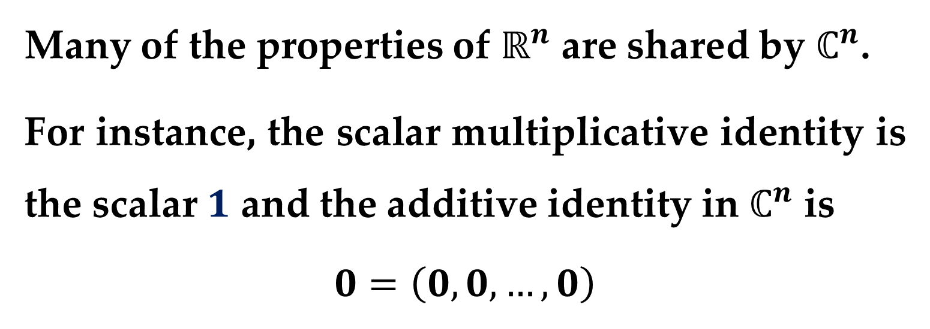
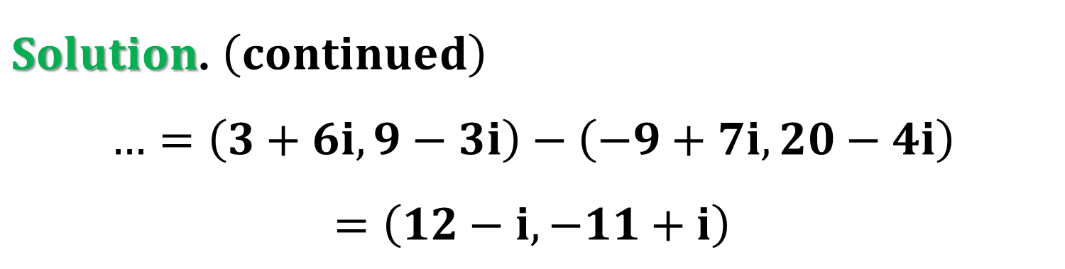
$Solution$. $\left(continued\right)$
$$…=\left(3+6i,9−3i\right)−\left(−9+7i,20−4i\right)$$
$$=\left(12−i,−11+i\right)$$
Many of the properties of $ℝ^{n}$ are shared by $ℂ^{n}$.
For instance, the scalar multiplicative identity is the scalar $1$ and the additive identity in $ℂ^{n}$ is
$$0=\left(0,0,…,0\right)$$

Slide 9
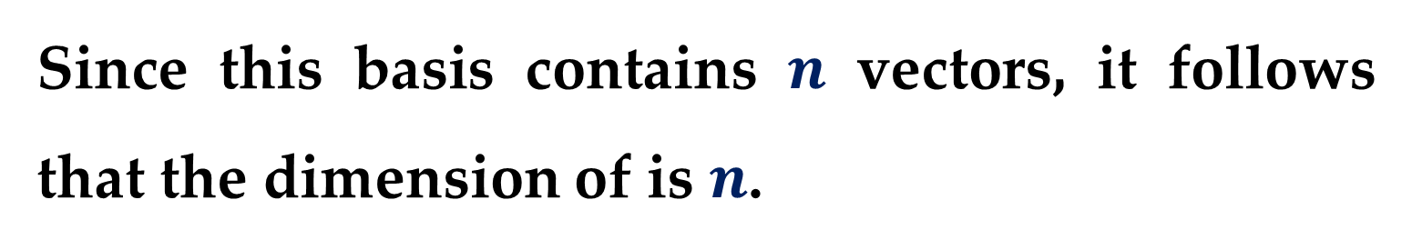
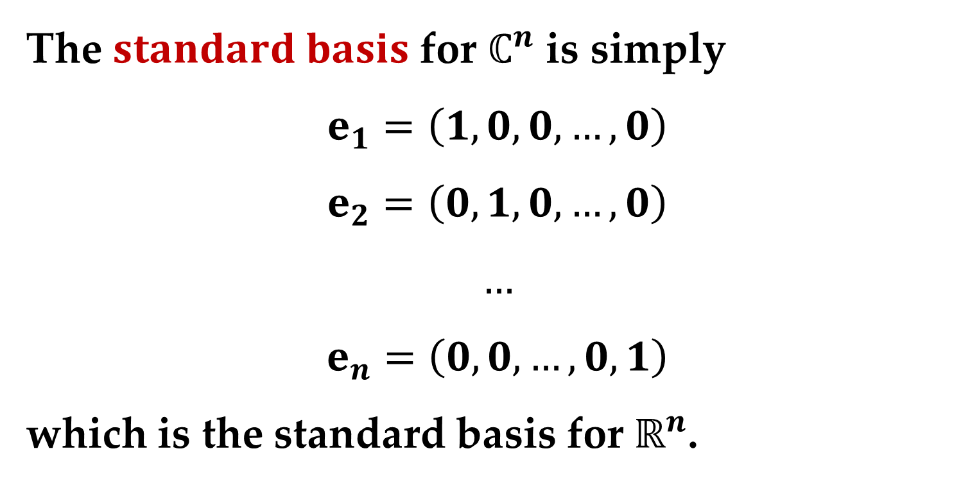
The $standard basis$ for $ℂ^{n}$ is simply
$$e_{1}=\left(1,0,0,…,0\right)$$
$$e_{2}=\left(0,1,0,…,0\right)$$
$$…$$
$$e_{n}=\left(0,0,…,0,1\right)$$
which is the standard basis for $ℝ^{n}$.
Since this basis contains $n$ vectors, it follows that the dimension of is $n$.

Slide 10
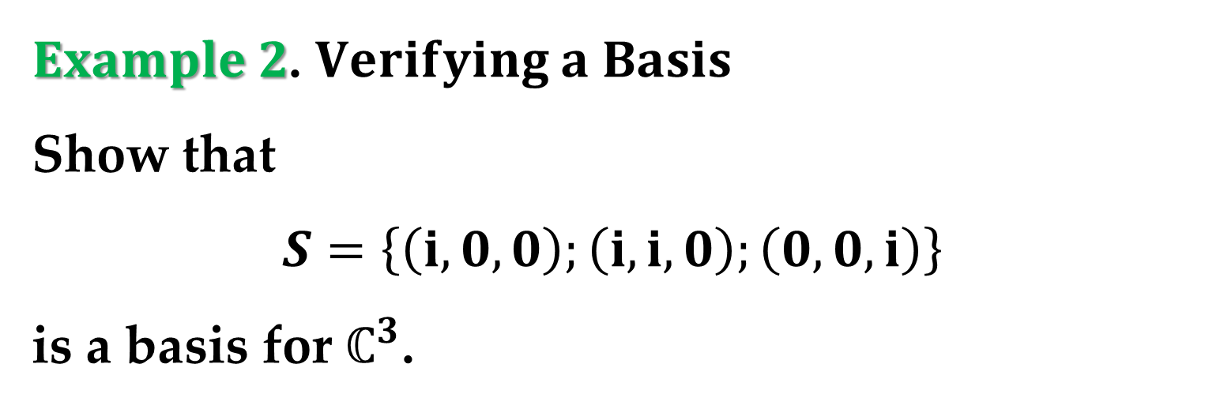
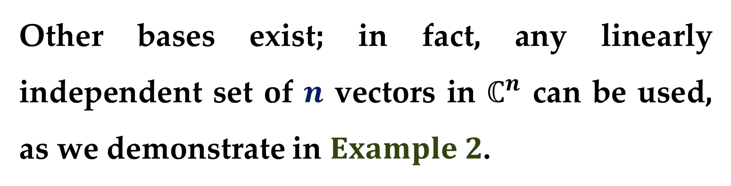
Other bases exist; in fact, any linearly independent set of $n$ vectors in $ℂ^{n}$ can be used, as we demonstrate in $Example 2$.
$Example 2$. $Verifying a Basis$
Show that
$$S=\left\{\left(i,0,0\right);\left(i,i,0\right);\left(0,0,i\right)\right\}$$
is a basis for $ℂ^{3}$.

Slide 11
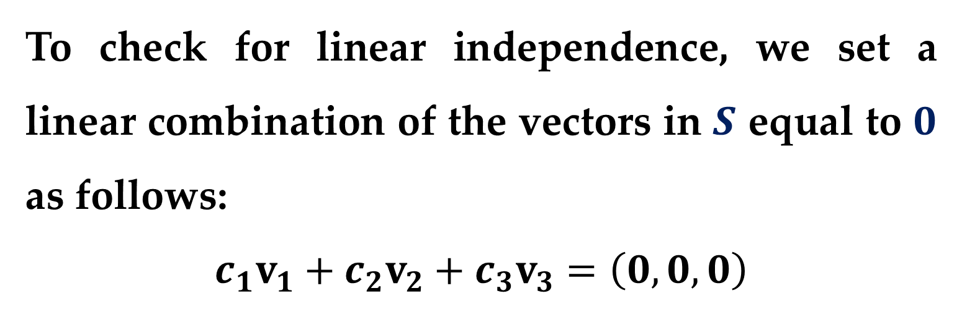
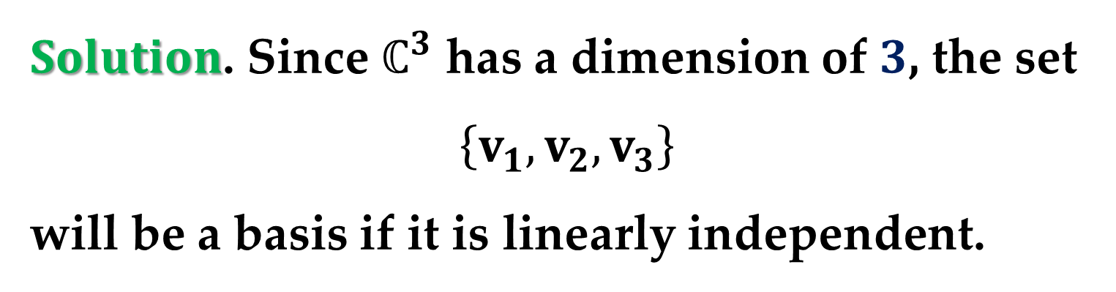
$Solution$. Since $ℂ^{3}$ has a dimension of $3$, the set
$$\left\{v_{1},v_{2},v_{3}\right\}$$
will be a basis if it is linearly independent.
To check for linear independence, we set a linear combination of the vectors in $S$ equal to $0$ as follows:
$$c_{1}v_{1}+c_{2}v_{2}+c_{3}v_{3}=\left(0,0,0\right)$$
$$\left(c_{1}i,0,0\right)+\left(c_{2}i,c_{2}i,0\right)+\left(0,0,c_{3}i\right)=\left(0,0,0\right)$$

Slide 12


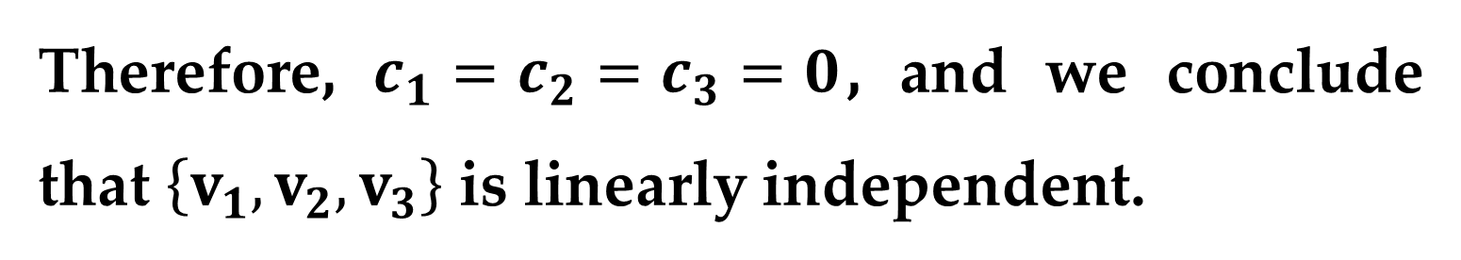
$Solution$. $\left(continued\right)$
$$\left(\left(c_{1}+c_{2}\right)i,c_{2}i,c_{3}i\right)=\left(0,0,0\right)$$
This implies that
$$\left(c_{1}+c_{2}\right)i=0$$
$$c_{2}i=0$$
$$c_{3}i=0$$
Therefore, $c_{1}=c_{2}=c_{3}=0$, and we conclude that $\left\{v_{1},v_{2},v_{3}\right\}$ is linearly independent.

Slide 13
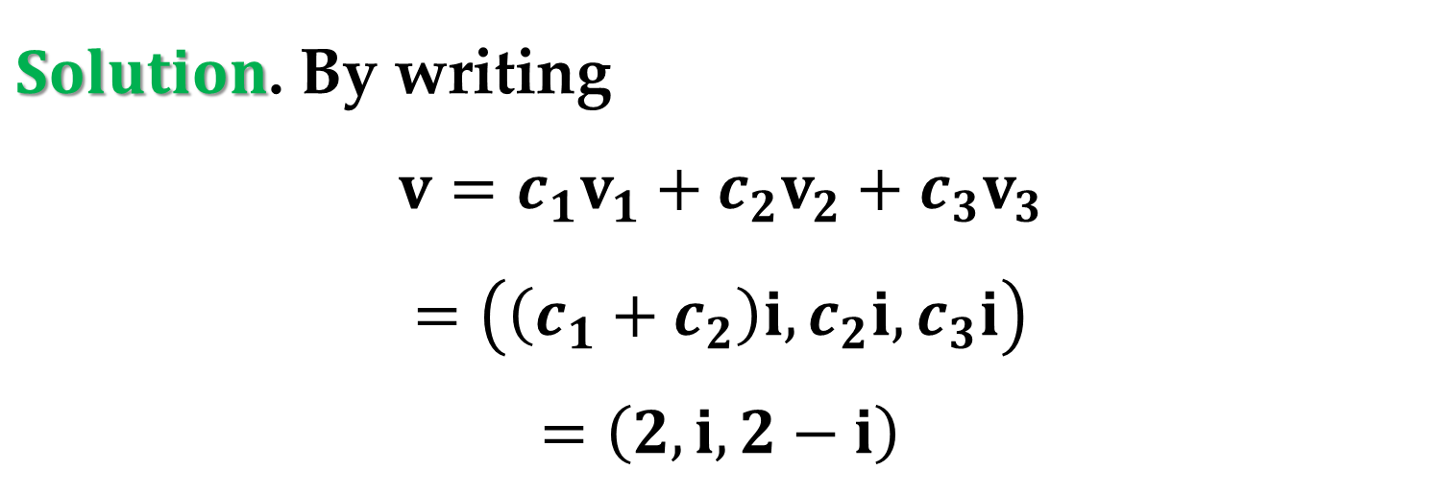
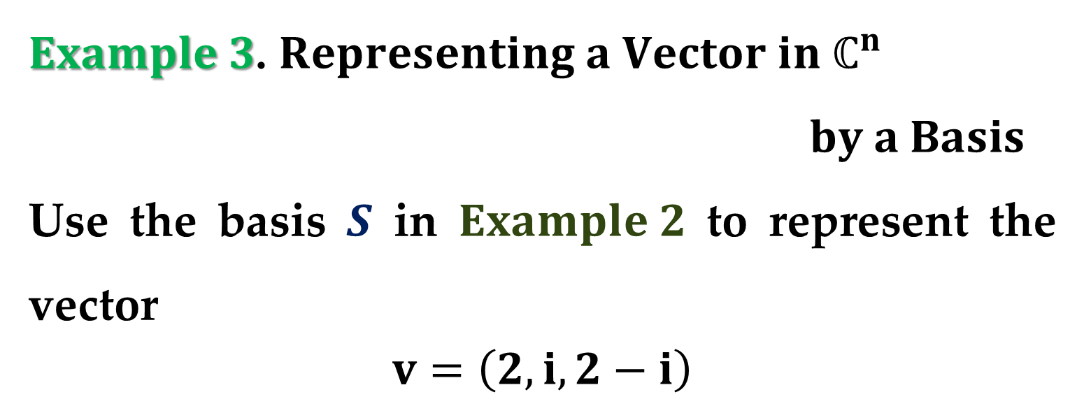
$Example 3$. $Representing a Vector in ℂ^{n}$
$by a Basis$
Use the basis $S$ in $Example 2$ to represent the vector
$$v=\left(2,i,2−i\right)$$
$Solution$. By writing
$$v=c_{1}v_{1}+c_{2}v_{2}+c_{3}v_{3}$$
$$=\left(\left(c_{1}+c_{2}\right)i,c_{2}i,c_{3}i\right)$$
$$=\left(2,i,2−i\right)$$

Slide 14

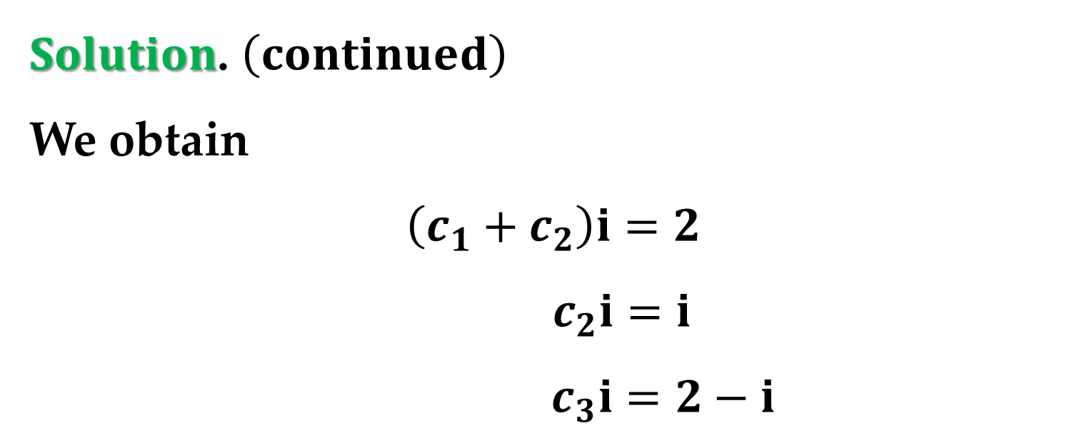
$Solution$. $\left(continued\right)$
We obtain
$$\left(c_{1}+c_{2}\right)i=2$$
$$c_{2}i=i$$
$$c_{3}i=2−i$$
which implies that $c_{2}=1$ and
$$c_{1}=c_{3}=\frac{2−i}{i}=−1−2i$$

Slide 15

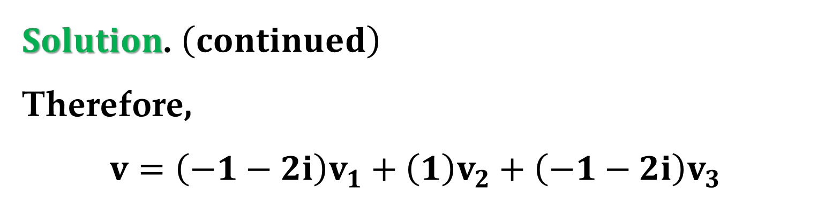
$Solution$. $\left(continued\right)$
Therefore,
$$v=\left(−1−2i\right)v_{1}+\left(1\right)v_{2}+\left(−1−2i\right)v_{3}$$
Try verifying that this linear combination yields
$$\left(2,i,2−i\right)$$

Slide 16
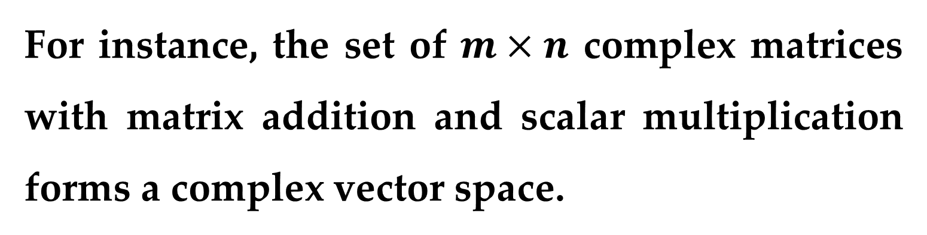


Other than $ℂ^{n}$, there are several additional examples of complex vector spaces.
For instance, the set of $m×n$ complex matrices with matrix addition and scalar multiplication forms a complex vector space.
$Example 4$ describes a complex vector space in which the vectors are functions.

Slide 17
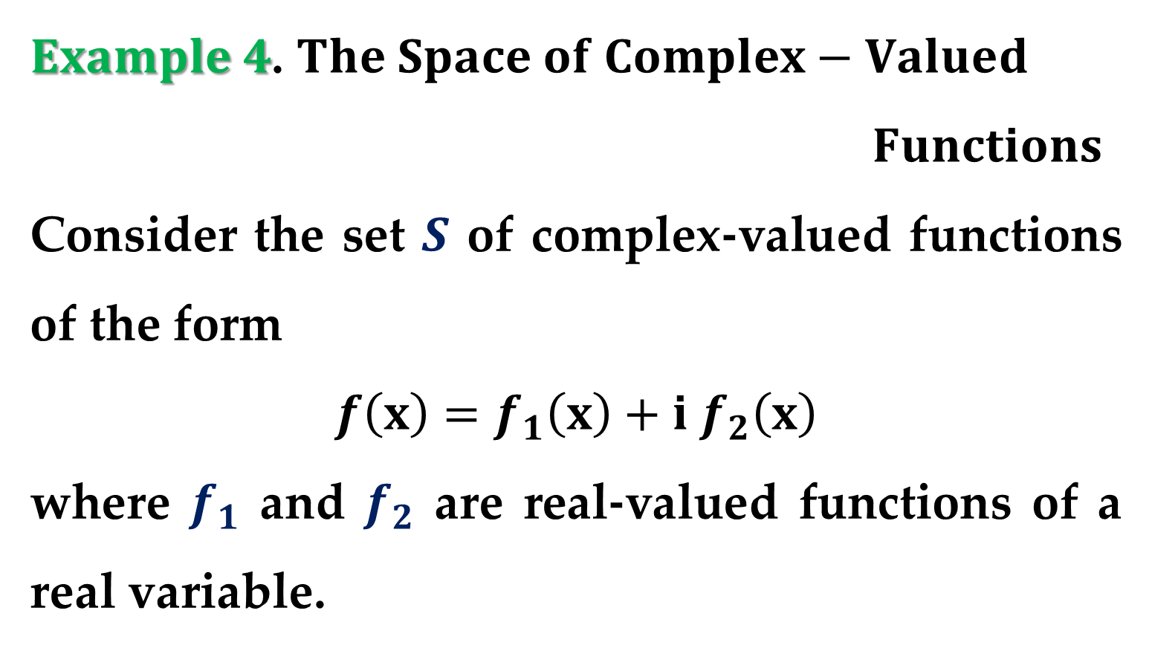
$Example 4$. $The Space of Complex−Valued$
$Functions$
Consider the set $S$ of complex-valued functions of the form
$$f\left(x\right)=f_{1}\left(x\right)+i f_{2}\left(x\right)$$
where $f_{1}$ and $f_{2}$ are real-valued functions of a real variable.

Slide 18
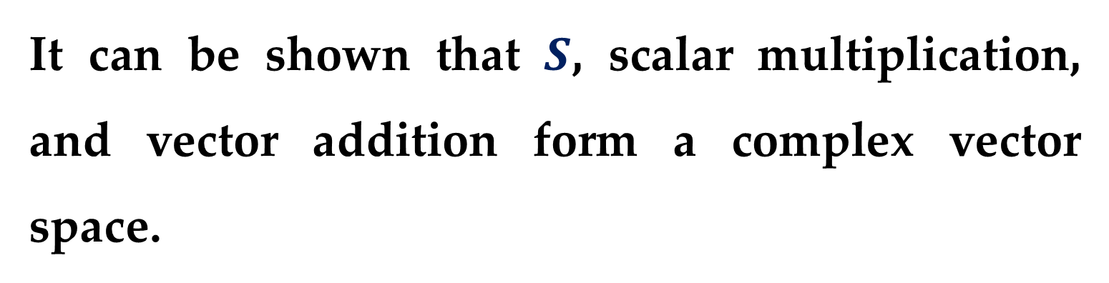
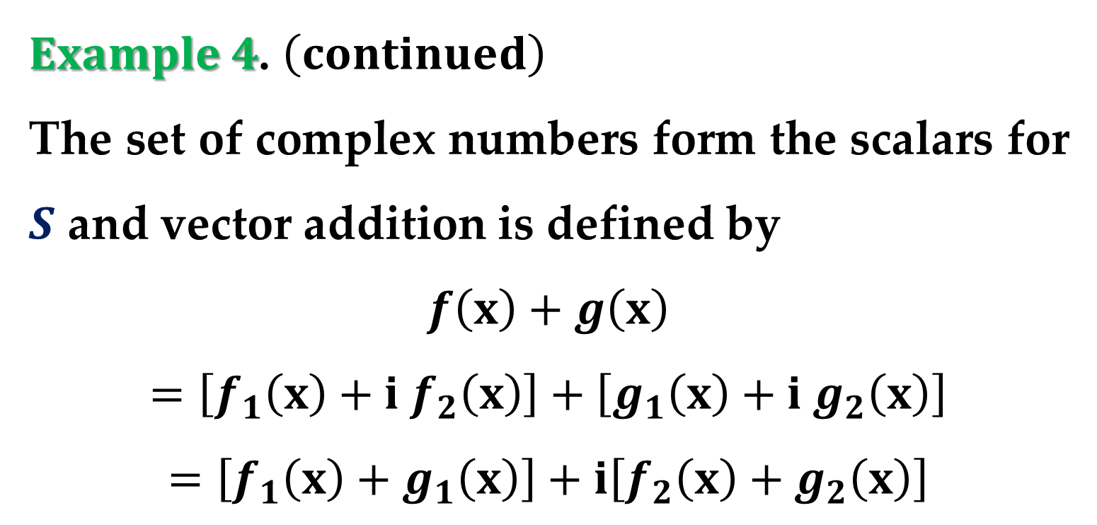
$Example 4$. $\left(continued\right)$
The set of complex numbers form the scalars for $S$ and vector addition is defined by
$$f\left(x\right)+g\left(x\right)$$
$$=\left[f_{1}\left(x\right)+i f_{2}\left(x\right)\right]+\left[g_{1}\left(x\right)+i g_{2}\left(x\right)\right]$$
$$=\left[f_{1}\left(x\right)+g_{1}\left(x\right)\right]+i\left[f_{2}\left(x\right)+g_{2}\left(x\right)\right]$$
It can be shown that $S$, scalar multiplication, and vector addition form a complex vector space.

Slide 19
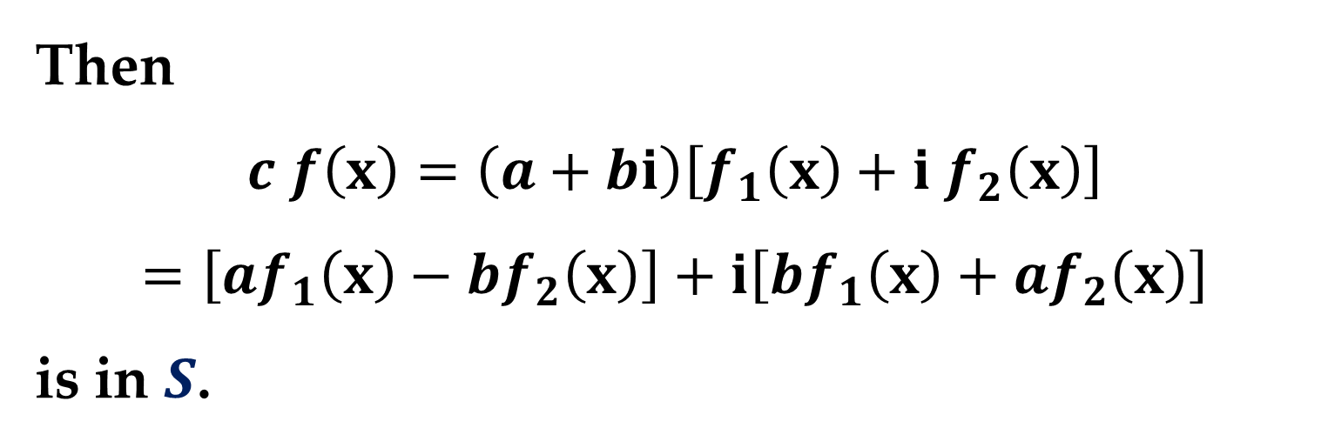
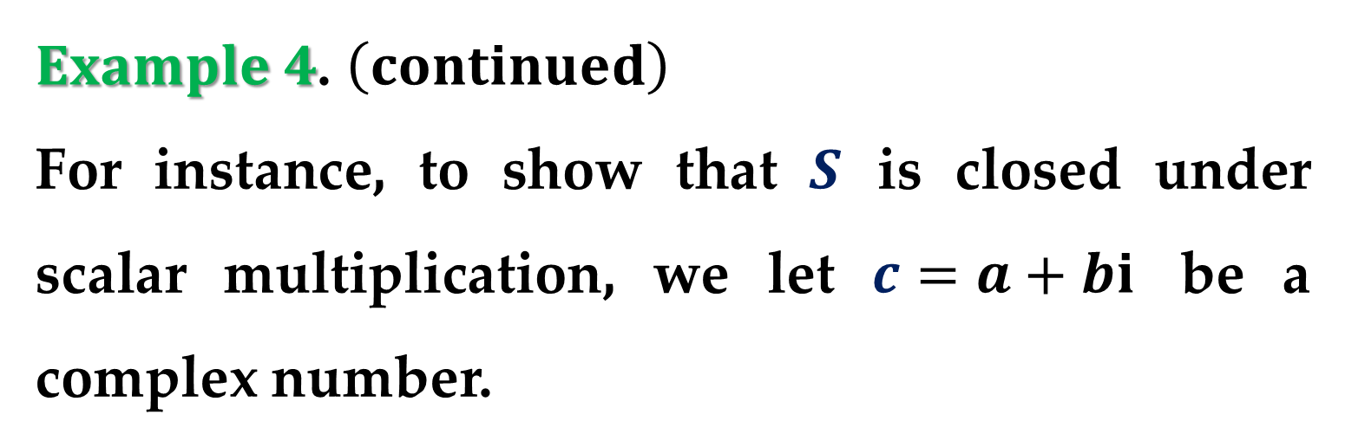
$Example 4$. $\left(continued\right)$
For instance, to show that $S$ is closed under scalar multiplication, we let $c=a+bi$ be a complex number.
Then
$$c f\left(x\right)=\left(a+bi\right)\left[f_{1}\left(x\right)+i f_{2}\left(x\right)\right]$$
$$=\left[af_{1}\left(x\right)−bf_{2}\left(x\right)\right]+i\left[bf_{1}\left(x\right)+af_{2}\left(x\right)\right]$$
is in $S$.

Slide 20
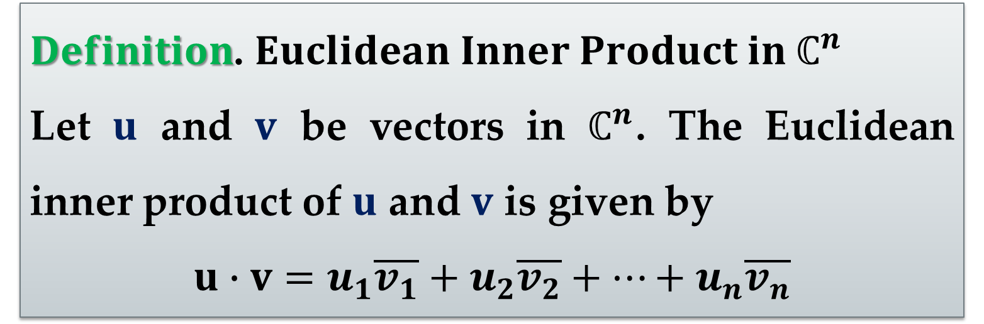
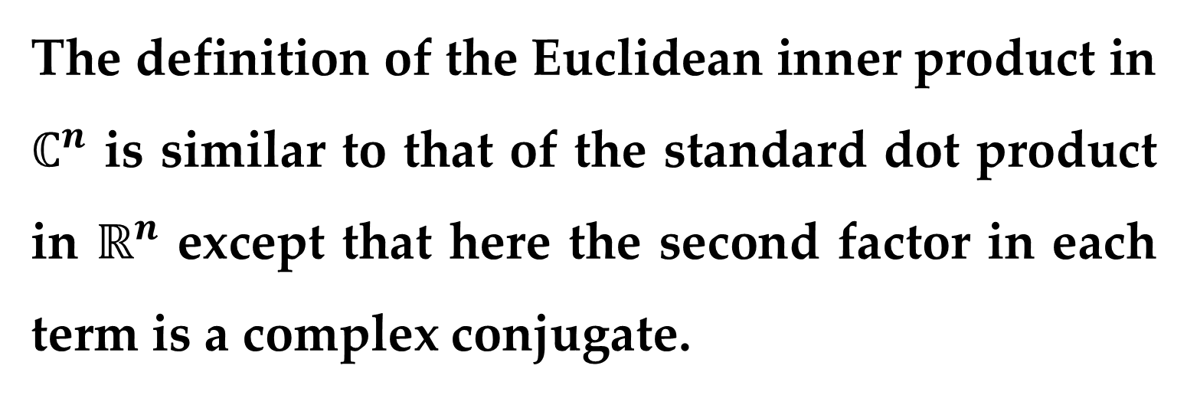
The definition of the Euclidean inner product in $ℂ^{n}$ is similar to that of the standard dot product in $ℝ^{n}$ except that here the second factor in each term is a complex conjugate.
$Definition$. $Euclidean Inner Product in ℂ^{n}$
Let $u$ and $v$ be vectors in $ℂ^{n}$. The Euclidean inner product of $u$ and $v$ is given by
$$u∙v=u_{1}\overline{v_{1}}+u_{2}\overline{v_{2}}+…+u_{n}\overline{v_{n}}$$

Slide 21
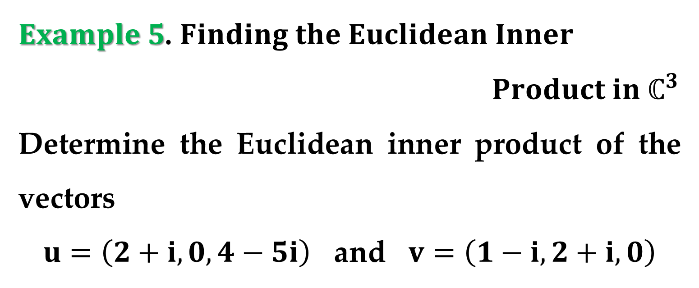
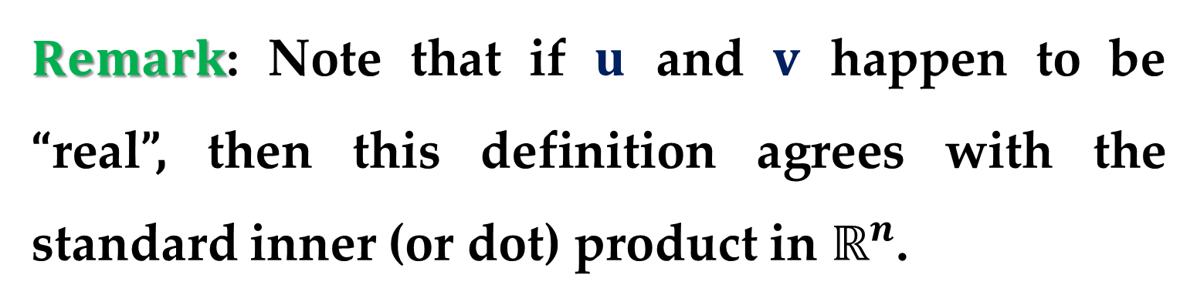
$Remark$: Note that if $u$ and $v$ happen to be “real”, then this definition agrees with the standard inner (or dot) product in $ℝ^{n}$.
$Example 5$. $Finding the Euclidean Inner$
$Product in ℂ^{3}$
Determine the Euclidean inner product of the vectors
$u=\left(2+i,0,4−5i\right)$ and $v=\left(1−i,2+i,0\right)$

Slide 22
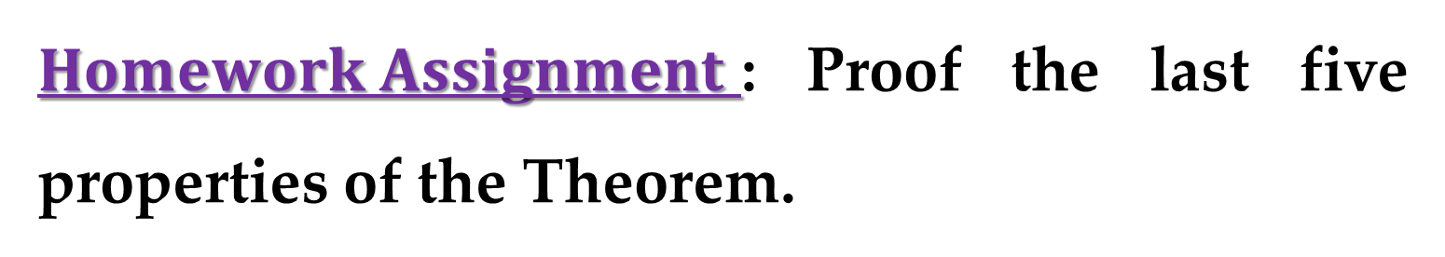

$Solution$. We have
$$u∙v=u_{1}\overline{v_{1}}+u_{2}\overline{v_{2}}+u_{3}\overline{v_{3}}$$
$$=\left(2+i\right)\left(1−i\right)+\left(0\right)\left(2+i\right)+\left(4−5i\right)\left(0\right)$$
$$=1−3i$$
Several properties of the Euclidean inner product are stated in the following theorem.
$Homework Assignment$: Proof the last five properties of the Theorem.

Slide 23
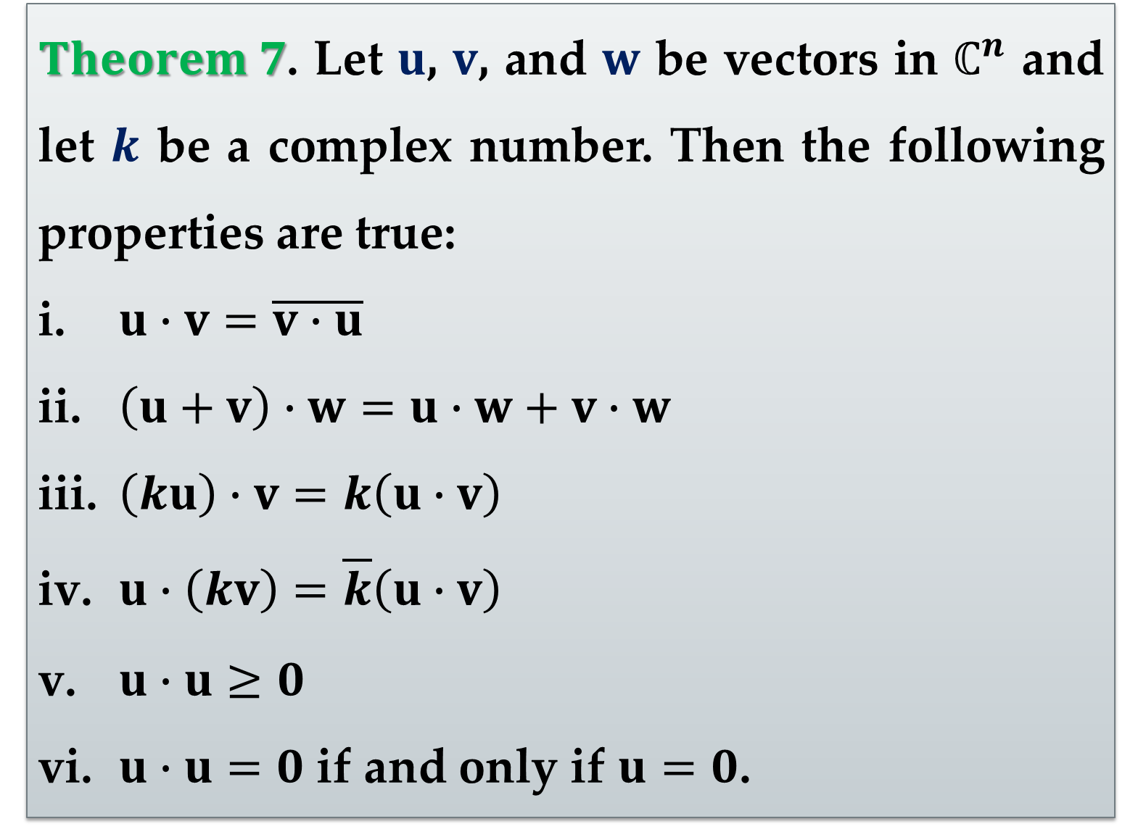
$Theorem 7$. Let $u$, $v$, and $w$ be vectors in $ℂ^{n}$ and let $k$ be a complex number. Then the following properties are true:
$u∙v=\overline{v∙u}$
$\left(u+v\right)∙w=u∙w+v∙w$
$\left(ku\right)∙v=k\left(u∙v\right)$
$u∙\left(kv\right)=\overline{k}\left(u∙v\right)$
$u∙u≥0$
$u∙u=0$ if and only if $u=0$.

Slide 24
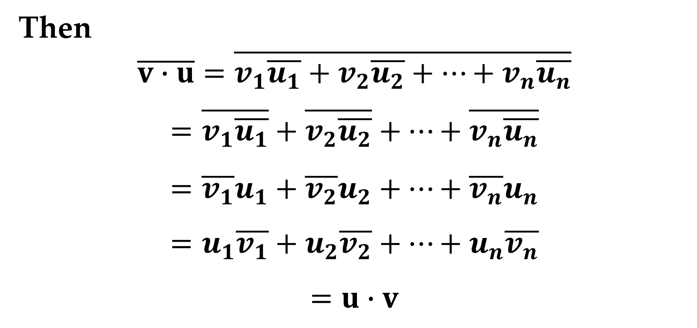
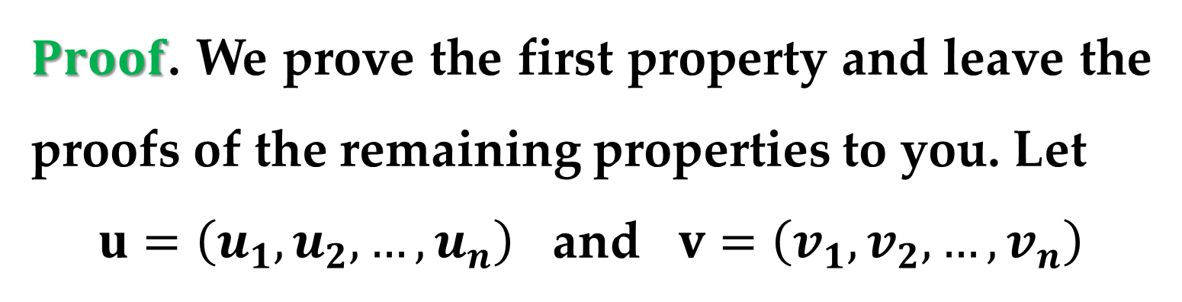
$Proof$. We prove the first property and leave the proofs of the remaining properties to you. Let
$u=\left(u_{1},u_{2},…,u_{n}\right)$ and $v=\left(v_{1},v_{2},…,v_{n}\right)$
Then
$$\overline{v∙u}=\overline{v_{1}\overline{u_{1}}+v_{2}\overline{u_{2}}+…+v_{n}\overline{u_{n}}}$$
$$=\overline{v_{1}\overline{u_{1}}}+\overline{v_{2}\overline{u_{2}}}+…+\overline{v_{n}\overline{u_{n}}}$$
$$=\overline{v_{1}}u_{1}+\overline{v_{2}}u_{2}+…+\overline{v_{n}}u_{n}$$
$$=u_{1}\overline{v_{1}}+u_{2}\overline{v_{2}}+…+u_{n}\overline{v_{n}}$$
$$=u∙v$$

Slide 25
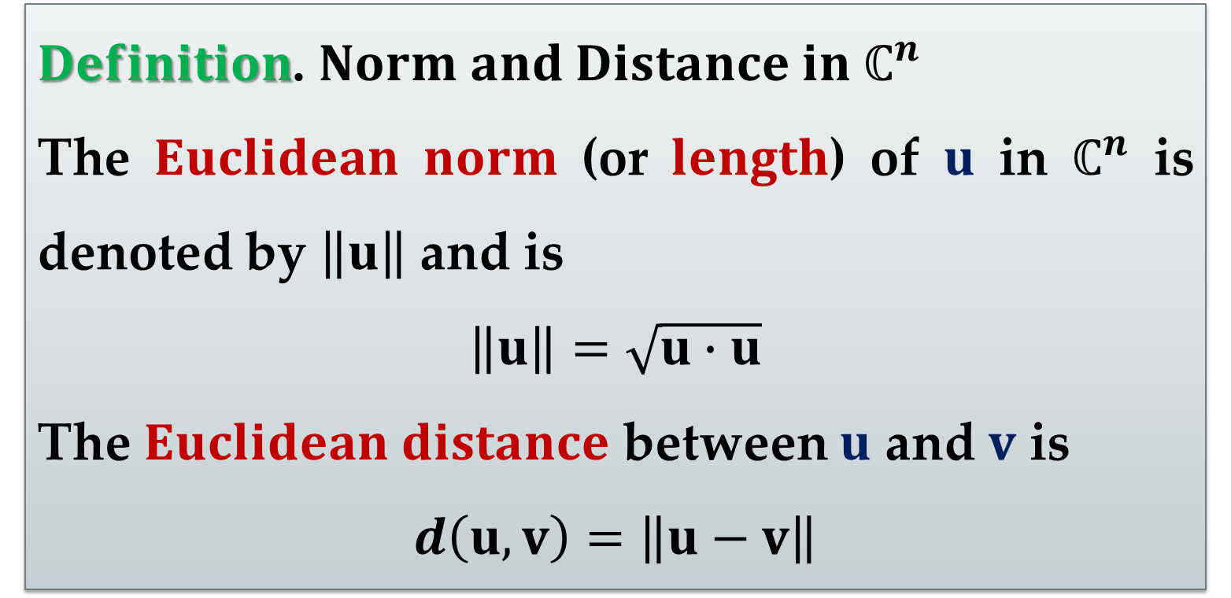
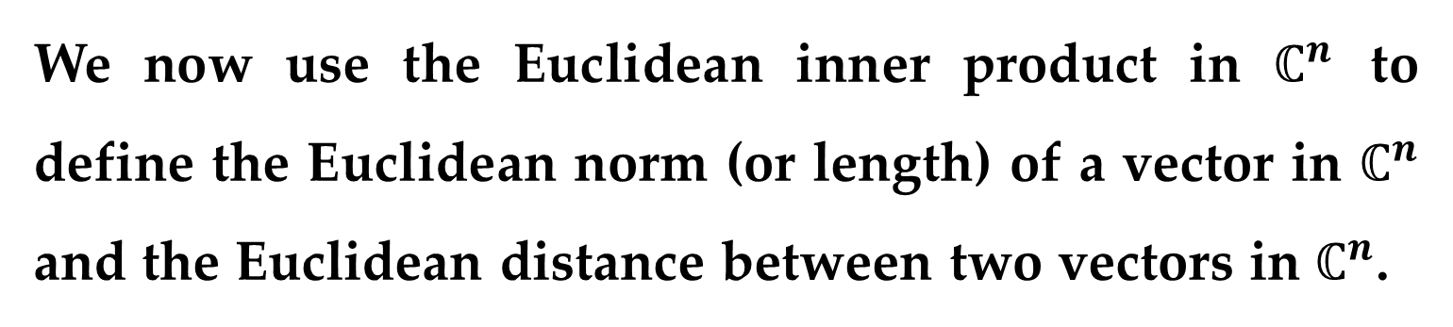
We now use the Euclidean inner product in $ℂ^{n}$ to define the Euclidean norm (or length) of a vector in $ℂ^{n}$ and the Euclidean distance between two vectors in $ℂ^{n}$.
$Definition$. $Norm and Distance in ℂ^{n}$
The $Euclidean norm$ (or $length$) of $u$ in $ℂ^{n}$ is denoted by $\left\|u\right\|$ and is
$$\left\|u\right\|=\sqrt{u∙u}$$
The $Euclidean distance$ between $u$ and $v$ is
$$d\left(u,v\right)=\left\|u−v\right\|$$

Slide 26
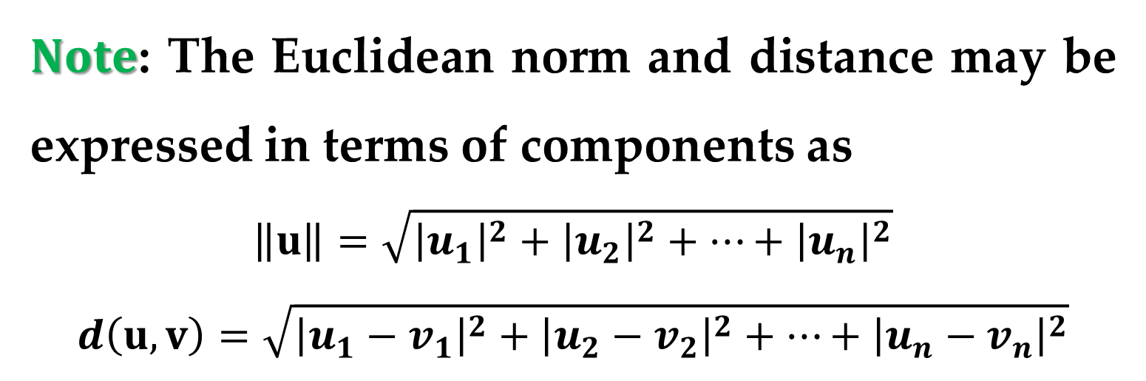
$Note$: The Euclidean norm and distance may be expressed in terms of components as
$$\left\|u\right\|=\sqrt{{\left|u_{1}\right|}^{2}+{\left|u_{2}\right|}^{2}+…+{\left|u_{n}\right|}^{2}}$$
$$d\left(u,v\right)=\sqrt{{\left|u_{1}−v_{1}\right|}^{2}+{\left|u_{2}−v_{2}\right|}^{2}+…+{\left|u_{n}−v_{n}\right|}^{2}}$$

Slide 27
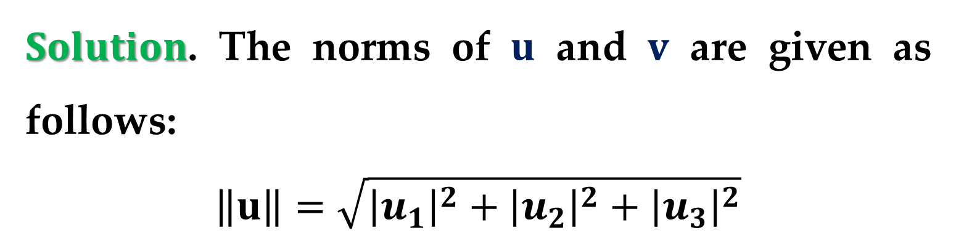
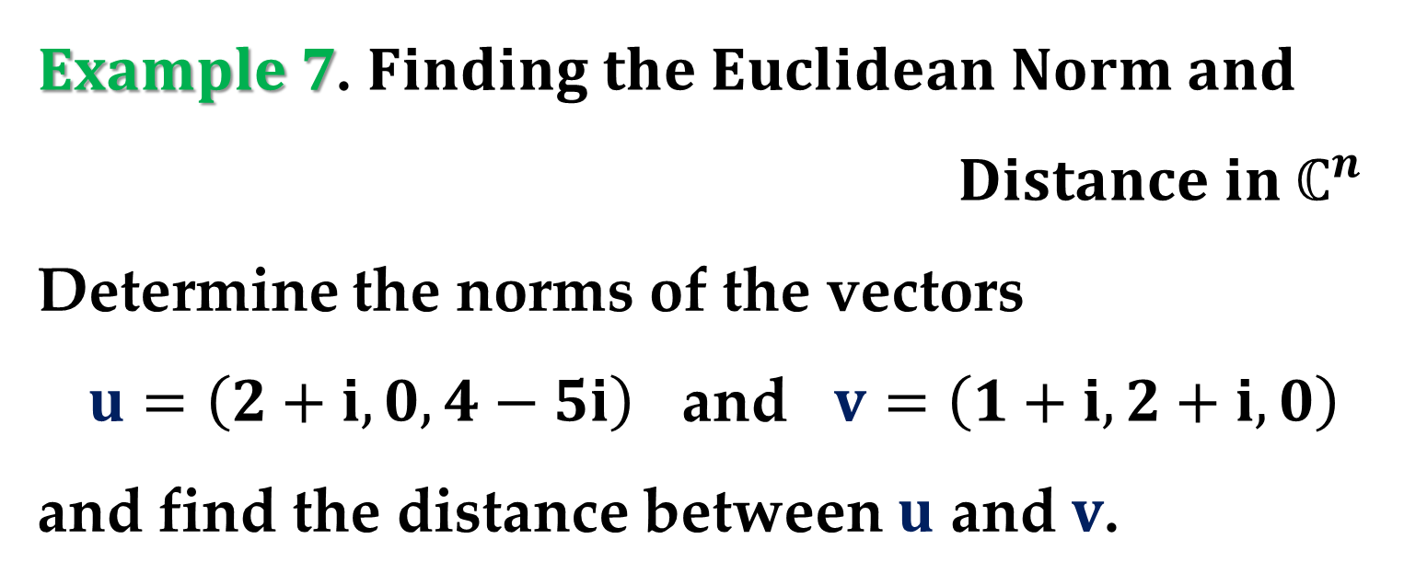
$Example 7$. $Finding the Euclidean Norm and$
$Distance in ℂ^{n}$
Determine the norms of the vectors
$u=\left(2+i,0,4−5i\right)$ and $v=\left(1+i,2+i,0\right)$
and find the distance between $u$ and $v$.
$Solution$. The norms of $u$ and $v$ are given as follows:
$$\left\|u\right\|=\sqrt{{\left|u_{1}\right|}^{2}+{\left|u_{2}\right|}^{2}+{\left|u_{3}\right|}^{2}}$$

Slide 28
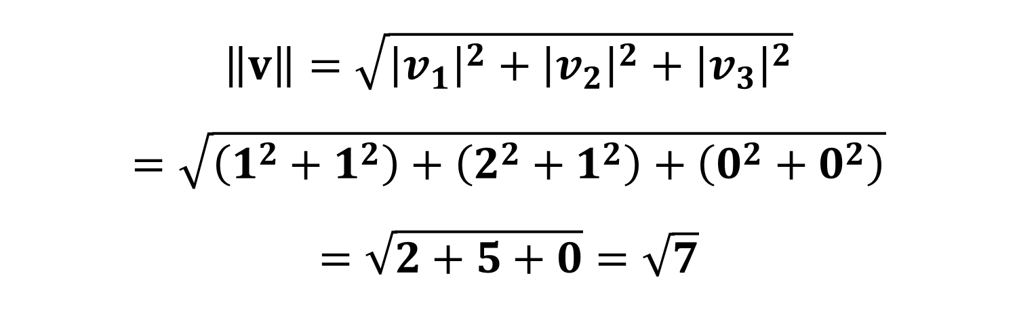
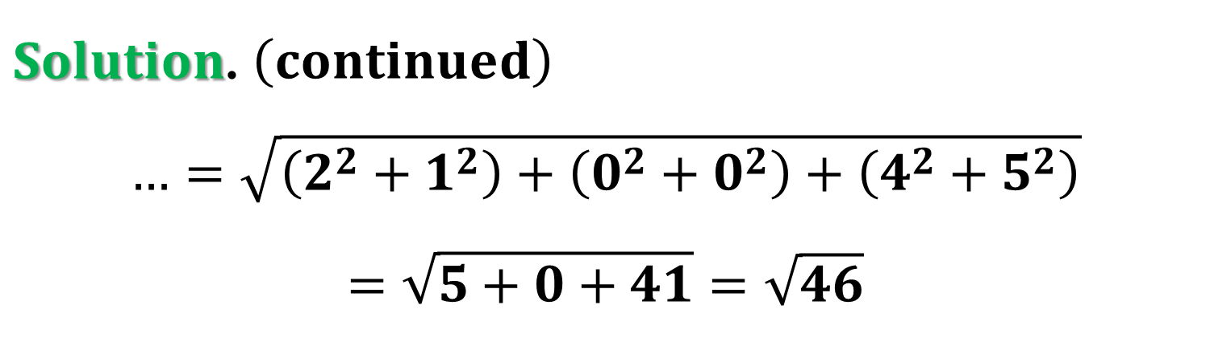
$Solution$. $\left(continued\right)$
$$…=\sqrt{\left(2^{2}+1^{2}\right)+\left(0^{2}+0^{2}\right)+\left(4^{2}+5^{2}\right)}$$
$$=\sqrt{5+0+41}=\sqrt{46}$$
$$\left\|v\right\|=\sqrt{{\left|v_{1}\right|}^{2}+{\left|v_{2}\right|}^{2}+{\left|v_{3}\right|}^{2}}$$
$$=\sqrt{\left(1^{2}+1^{2}\right)+\left(2^{2}+1^{2}\right)+\left(0^{2}+0^{2}\right)}$$
$$=\sqrt{2+5+0}=\sqrt{7}$$

Slide 29
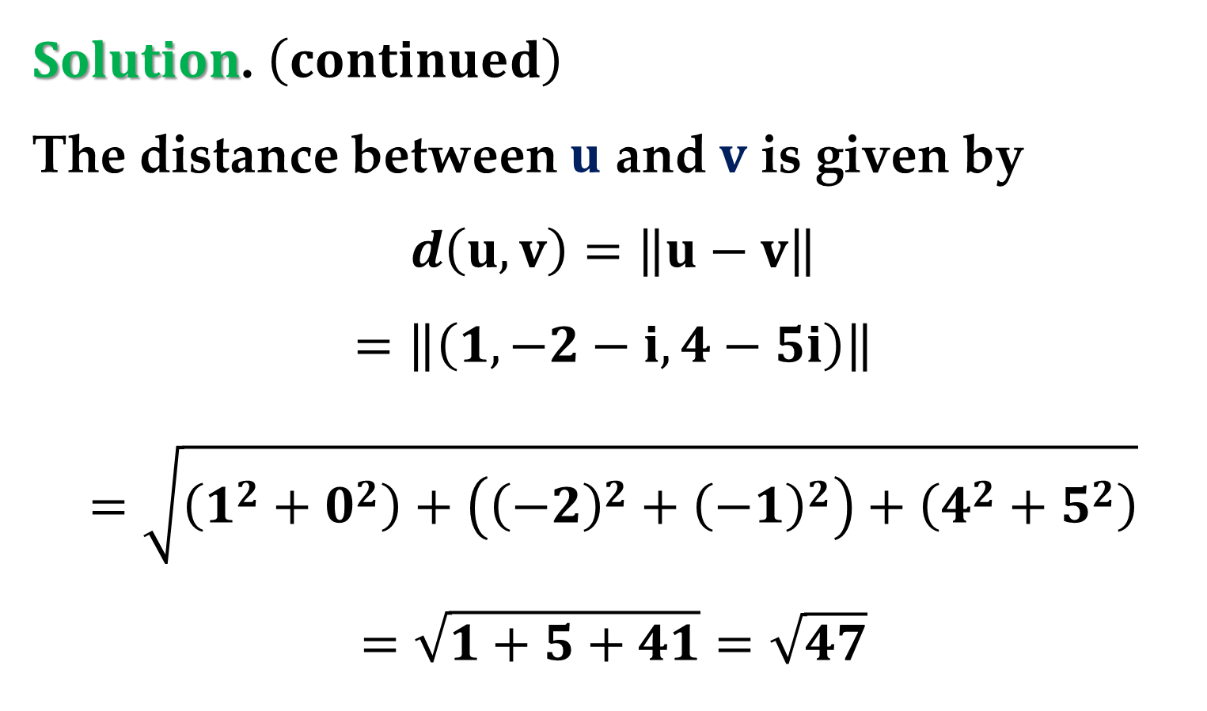
$Solution$. $\left(continued\right)$
The distance between $u$ and $v$ is given by
$$d\left(u,v\right)=\left\|u−v\right\|$$
$$=\left\|\left(1,−2−i,4−5i\right)\right\|$$
$$=\sqrt{\left(1^{2}+0^{2}\right)+\left({\left(−2\right)}^{2}+{\left(−1\right)}^{2}\right)+\left(4^{2}+5^{2}\right)}$$
$$=\sqrt{1+5+41}=\sqrt{47}$$

Slide 30
Complex Inner Product Spaces

Slide 31


The Euclidean inner product is the most commonly used inner product in $ℂ^{n}$.
However, on occasion it is useful to consider other inner products.
To generalize the notion of an inner product, we use the properties listed in $Theorem 7$.

Slide 32
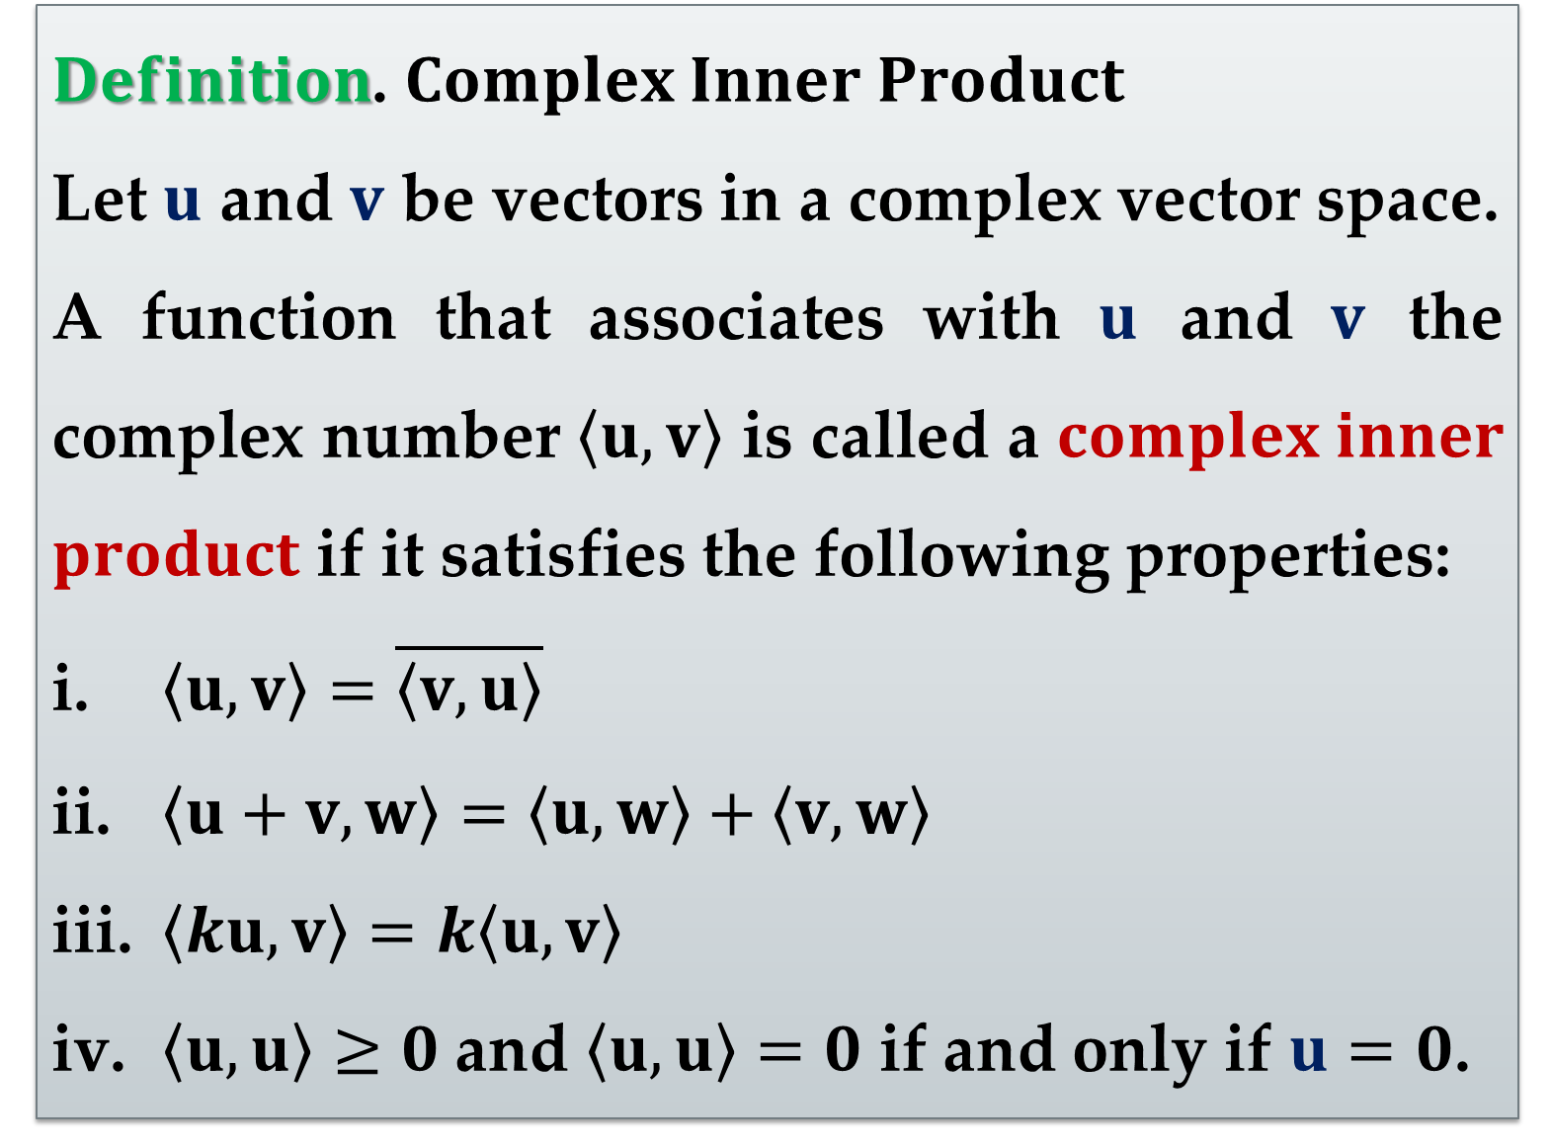
$Definition$. $Complex Inner Product$
Let $u$ and $v$ be vectors in a complex vector space.
A function that associates with $u$ and $v$ the complex number $\left\langle u,v\right\rangle$ is called a $complex inner$ $product$ if it satisfies the following properties:
$\left\langle u,v\right\rangle =\overline{\left\langle v,u\right\rangle }$
$\left\langle u+v,w\right\rangle =\left\langle u,w\right\rangle +\left\langle v,w\right\rangle$
$\left\langle ku,v\right\rangle =k\left\langle u,v\right\rangle$
$\left\langle u,u\right\rangle ≥0$ and $\left\langle u,u\right\rangle =0$ if and only if $u=0$.

Slide 33
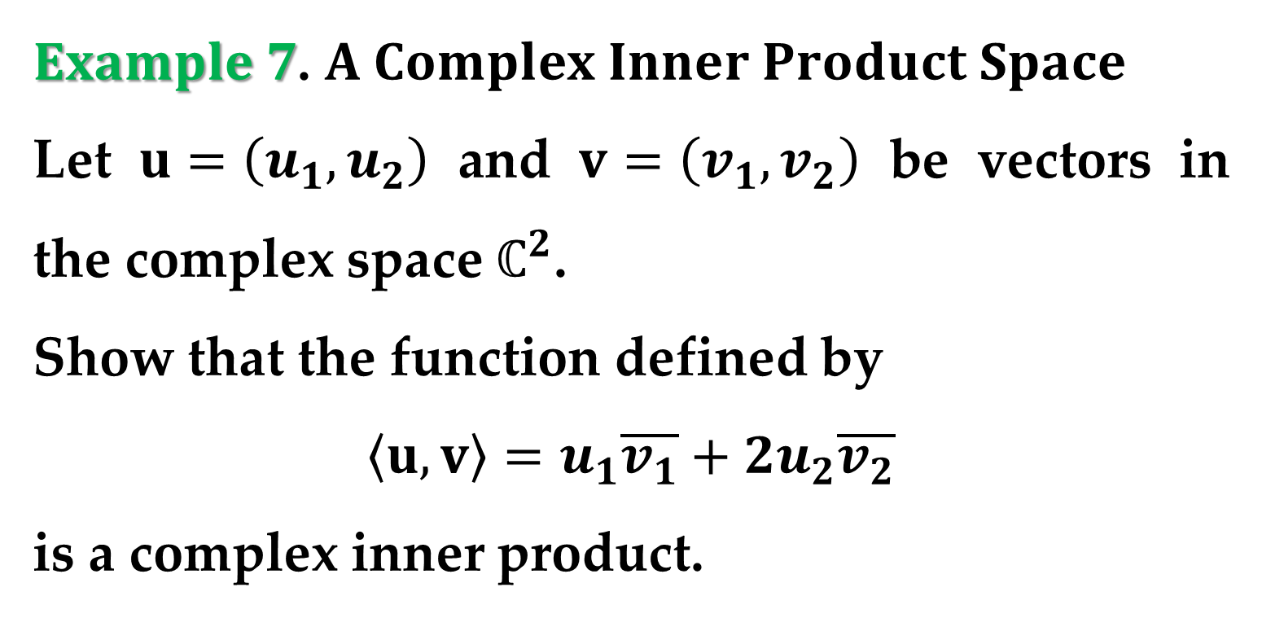
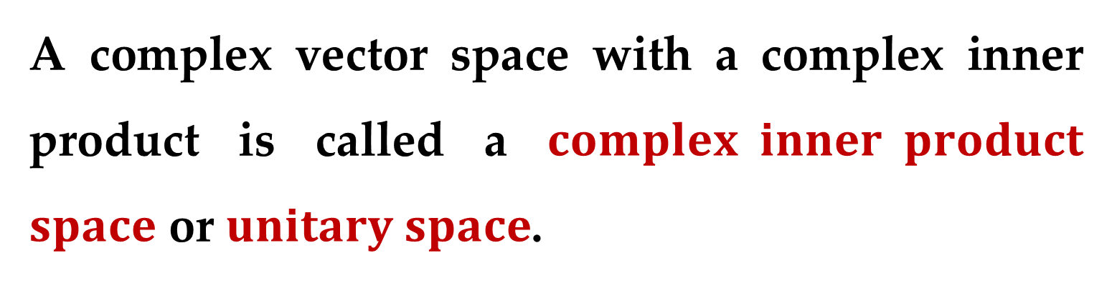
A complex vector space with a complex inner product is called a $complex inner product$ $space$ or $unitary space$.
$Example 7$. $A Complex Inner Product Space$
Let $u=\left(u_{1},u_{2}\right)$ and $v=\left(v_{1},v_{2}\right)$ be vectors in the complex space $ℂ^{2}$.
Show that the function defined by
$$\left\langle u,v\right\rangle =u_{1}\overline{v_{1}}+2u_{2}\overline{v_{2}}$$
is a complex inner product.

Slide 34
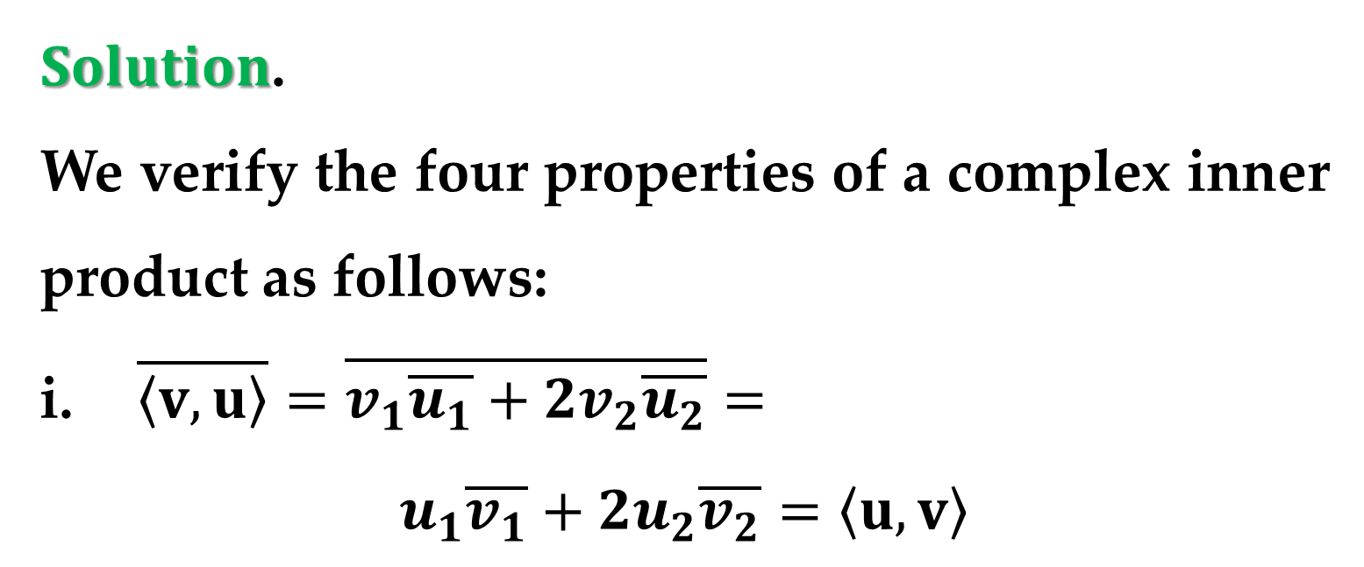

$Solution$.
We verify the four properties of a complex inner product as follows:
$\overline{\left\langle v,u\right\rangle }=\overline{v_{1}\overline{u_{1}}+2v_{2}\overline{u_{2}}}=$
$$u_{1}\overline{v_{1}}+2u_{2}\overline{v_{2}}=\left\langle u,v\right\rangle$$
$\left\langle u+v,w\right\rangle =\left(u_{1}+v_{1}\right)\overline{w_{1}}+2\left(u_{2}+v_{2}\right)\overline{w_{2}}$
$$=\left(u_{1}\overline{w_{1}}+2u_{2}\overline{w_{2}}\right)+\left(v_{1}\overline{w_{1}}+2v_{2}\overline{w_{2}}\right)$$
$$=\left\langle u,w\right\rangle +\left\langle v,w\right\rangle$$

Slide 35




$Solution$. $\left(continued\right)$
$\left\langle ku,v\right\rangle =\left(ku_{1}\right)\overline{v_{1}}+2\left(ku_{2}\right)\overline{v_{2}}$
$$=k\left(u_{1}\overline{v_{1}}+2u_{2}\overline{v_{2}}\right)=k\left\langle u,v\right\rangle$$
$$\left\langle u,u\right\rangle =u_{1}\overline{u_{1}}+2u_{2}\overline{u_{2}}$$
$$={\left|u_{1}\right|}^{2}+2{\left|u_{2}\right|}^{2}≥0$$
Moreover, $\left\langle u,u\right\rangle =0$ if and only if $u_{1}=u_{2}=0$.
Since all properties hold, $\left\langle u,v\right\rangle$ is a complex inner product.

Slide 36
Thank you very much!

